Slide 1

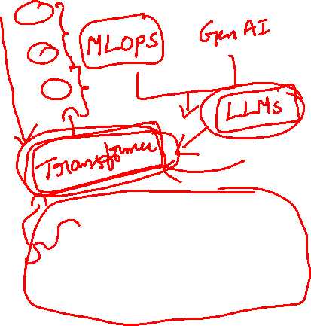
Seq2Seq & Attention in NLP

Slide 2

Part | Task | Learner Expectations
Introduction (0–5 min) | Speaker introduction; discuss NLP applications | Understand session context; recall prior learning
Encoder-Decoder Fundamentals (5–25 min) | Sequential processing, NMT example, limitations | Grasp basics of encoder-decoder models and their challenges
Attention Models (25–65 min) | Motivation, mathematics, integration with encoder-decoder | Learn how attention improves translation; understand dynamic context vectors
Doubt Resolution (65–85 min) | Peer Q&A, clarifications, discussion | Resolve doubts; participate actively
Session Agenda – Seq2Seq & Attention in NLP

Slide 3
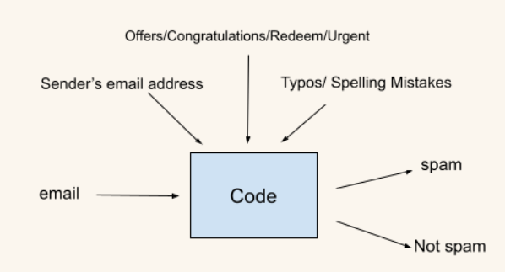
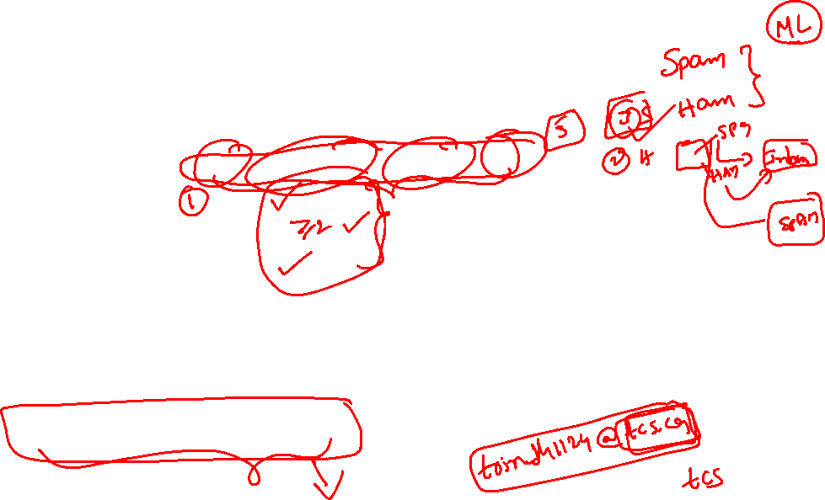
Rule-Based Spam Email Classification (Without Machine Learning)
Objective
Automatically classify emails as Spam or Not Spam using predefined logical rules.
Key Spam Indicators
Sender Email Address: Unrecognized or suspicious sender
Content Quality: High number of typos or spelling mistakes
Spam Keywords: Presence of words like offers, congratulations, redeem, urgent
Classification Logic
Check sender against trusted list
Count spelling errors beyond a defined threshold
Scan email content for spam-related keywords
Decision Rule
If all conditions are met → SPAM
Otherwise → NOT SPAM
Key Characteristics
Simple and explainable
No training data required
Easy to implement, but limited in handling complex spam

Slide 4
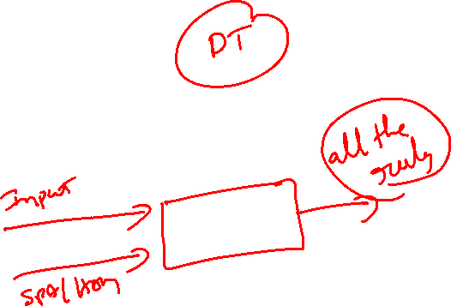

How Machine Learning Improves Classification
In a machine learning approach:
Input: Email content (subject, body, sender metadata)
Output: Labels (Spam / Not Spam)
The model automatically learns:
  Word usage patterns
  Writing style differences
  Contextual clues beyond simple keywords
Instead of manually defining rules, the model infers decision boundaries from data, making it more adaptable and scalable.

Slide 5
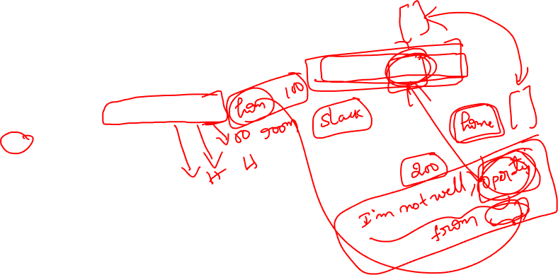
Autofill Text Prediction: From Simple Statistics to Context-Aware Models
Use Case
Autofill assistance in official platforms (e.g., Slack) when someone types "I'm not well, working from," the tool should predict "home" as the next word.
Basic Statistical Approach
Extract sentences starting with: “not well, working from”
Count common next-word completions:
  home → 100 occurrences
  room → 50 occurrences
  H (typo) → 6 occurrences
Compute probabilities for each completion
Predict the next word using random sampling from the distribution
Limitations
No semantic understanding
Fails on unseen but similar phrases (e.g., “operating from”)
Relies strictly on exact word matches
Evolution to Advanced Models
Modern NLP models learn context and meaning, not just frequency
Can generalize across similar phrases and unseen data
These advancements paved the way for transformer-based models, which excel at understanding and generating natural language text

Slide 6
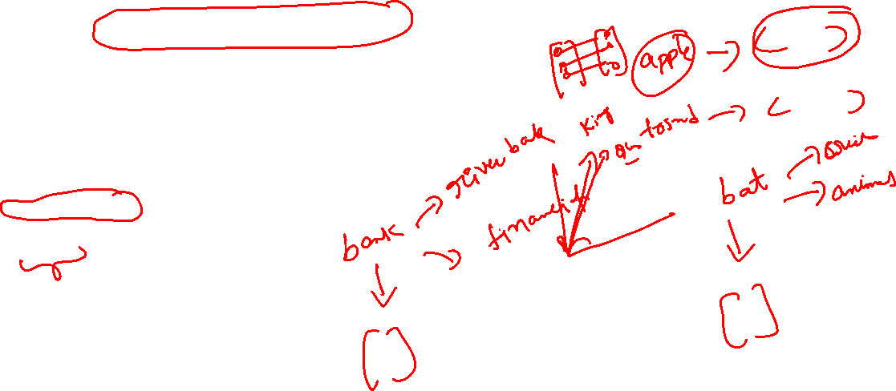
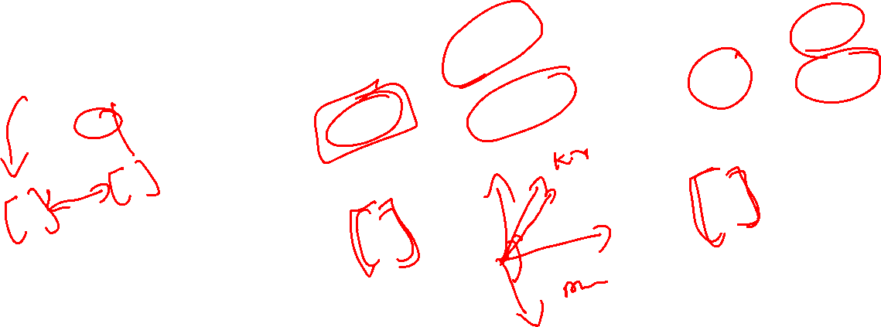
Word2Vec – Capturing Semantic Meaning with Vectors
What is Word2Vec?
A language model that converts words into numerical vector representations
Enables computers to process language using numbers
Example:
  apple → [0.1, 0.2, -0.3, 0.6, 0.3]
Core Objective
Capture semantic relationships between words
Words with similar meanings should have vectors close to each other
Measuring Similarity
Similarity is commonly measured using Euclidean distance
Smaller distance → higher semantic similarity
Example:
  king ↔ queen → small distance
  king ↔ apple → large distance

Slide 7

The Core Limitation of Word2Vec
Static Embeddings
One word → one vector
Same vector regardless of context
Example:
“bats” (animal)
“bats” (sports)
❌ Cannot differentiate meanings
What “context” means in Word2Vec
In Word2Vec:
Context is used during training
The model learns a word’s vector by predicting:
  Surrounding words (Skip-gram), or
  The target word from surrounding words (CBOW)
Example sentences:
“The bats are flying at night”
“He bought new bats for the match”
Lack of Context Awareness
Word2Vec assigns one vector per word, regardless of context
Example:
  bats (animal) vs bats (sports equipment)
  Same vector → different meanings ignored
Word2Vec uses context to learn embeddings, but it produces one fixed vector per word.
So even though “bats” appears in different contexts during training, the final output is still a single embedding for “bats”.
During training:
That vector is updated using all occurrences
The result is an average of all contexts
👉 This is why Word2Vec embeddings are called static embeddings

Slide 8

Why Static Embeddings Fail in Real NLP Tasks
Sentiment Analysis Example
“The movie is good” → Positive
“The movie is so good it cured my insomnia” → Negative (sarcasm)
Word2Vec:
Focuses on “good”
Misses sequence-level meaning
👉 Word meaning alone is insufficient — we need sentence meaning

Slide 9
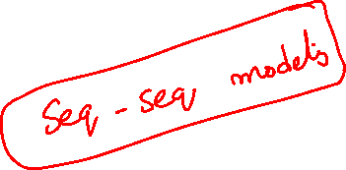
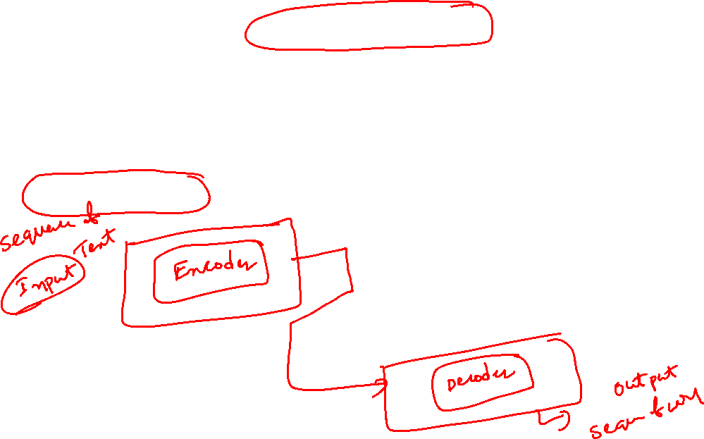
From Context Limitations to Encoder–Decoder Models in NLP
Recap: Limitations of Earlier NLP Models
Traditional models (e.g., n-grams, Word2Vec) struggle with context-specific meanings
Same word may have different meanings depending on usage
Leads to errors in tasks such as sentiment analysis
Need for Advanced Models
Modern NLP tasks require:
  Context preservation
  Understanding of long and complex sentences
Encoder–Decoder Architecture
A powerful framework for sequence-to-sequence transformation

Slide 10
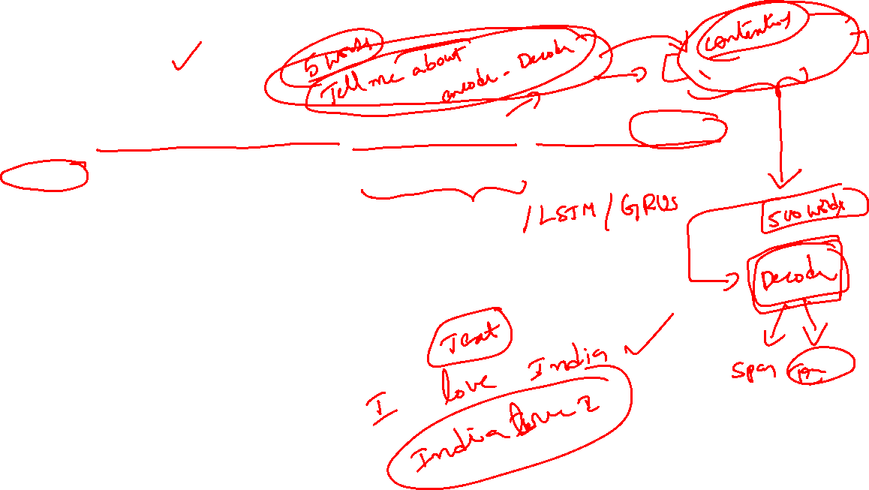
Encoder–Decoder Architecture (Overview)
The encoder–decoder architecture is a widely used framework for sequence-to-sequence tasks such as:
  Sentiment analysis
  Machine translation
It consists of two main components:
  Encoder: Converts an input sentence into a vector representation that captures contextual information
  Decoder: Uses this vector representation to perform the desired task (e.g., classification or translation)
The architecture typically employs Recurrent Neural Networks (RNNs):
  RNNs process the sentence sequentially
  This allows the model to capture context and word order
  Enables more accurate understanding of sentence meaning
Input and output sequences may differ in:
  Length
  Vocabulary
  Structure

Slide 11
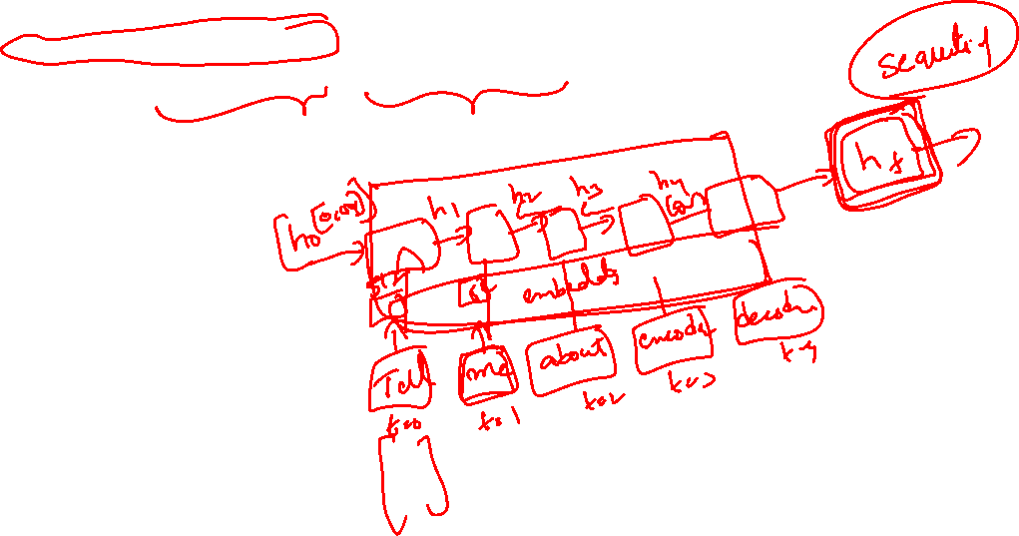
How the Encoder Works (Sequential Processing)
Reads the input sequence token by token
Updates its hidden state at each time step
Final hidden state summarizes the entire input sequence
Output of Encoder:
A fixed-length context vector
Intended to capture semantic and syntactic information of the input

Slide 12

How the Decoder Works (Sequential Generation)
Generates the output sequence one token at a time
At each step, the decoder:
  Uses the previous output token
  Uses its previous hidden state
  Conditions on the encoder’s context vector
Continues until an end-of-sequence token is produced

Slide 13
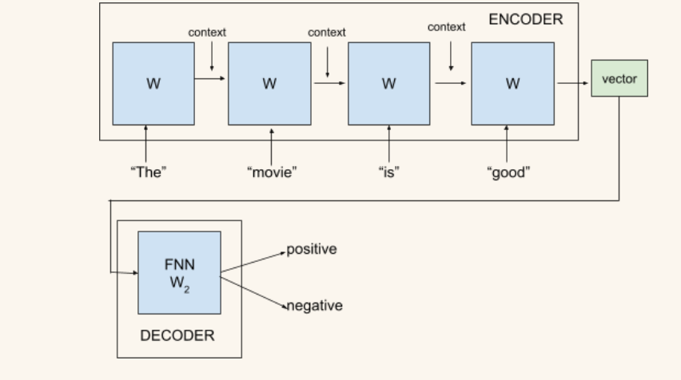
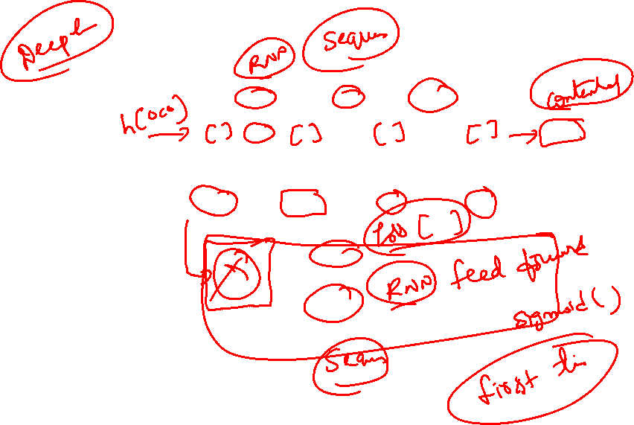
Encoder – Sequential Context Building with RNN
The Encoder processes the input sentence one word at a time using an RNN
For the first word “The”:
  The RNN performs matrix operations
  Generates an initial context (hidden state)
This context is passed to the next RNN cell along with the next word “movie”
Each RNN cell:
  Takes the previous context
  Combines it with the current word
  Produces a new, updated context
All RNN cells share the same weights, allowing:
  Handling of sentences of any length
  Consistent learning across positions in the sentence

Slide 14

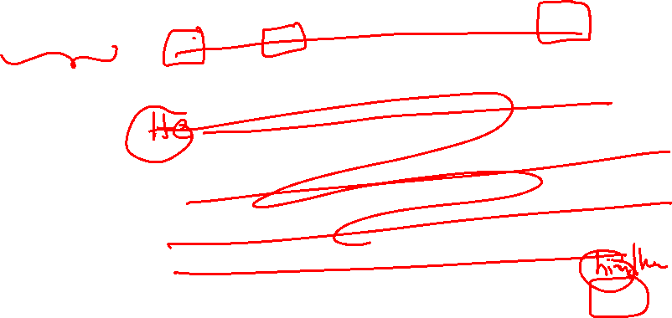
Decoder, Training, and Advantages over Word2Vec
After processing all words, the encoder produces a final vector representation
  Captures the overall context and meaning of the sentence
This vector is passed to the Decoder
  Typically, a feed-forward neural network
  Performs tasks such as sentiment classification (positive / negative)
During training:
  Initial predictions may be inaccurate
  Model improves by adjusting weights using feedback (loss minimization)
Limitations of basic RNNs:
  Long sentences may cause earlier context to fade
  Recent words can dominate the representation
Improvements:
  LSTMs and Bidirectional LSTMs help retain long-range dependencies
Key Advantage over Word2Vec:
Encoder–Decoder models produce context-sensitive representations
Unlike Word2Vec’s static word embeddings
Results in better performance on complex NLP tasks

Slide 15
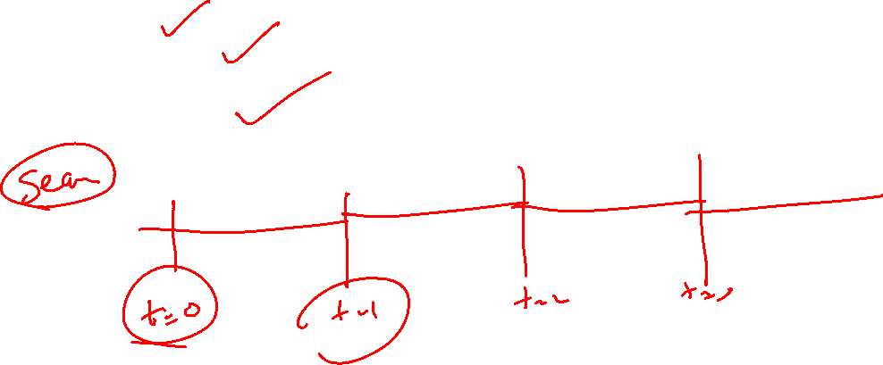
Sequential Nature of Encoder–Decoder Models
Both encoder and decoder operate sequentially
Each time step depends on the previous one
Consequences:
  Limited parallelization
  Slower training and inference
  Error propagation in long sequences

Slide 16
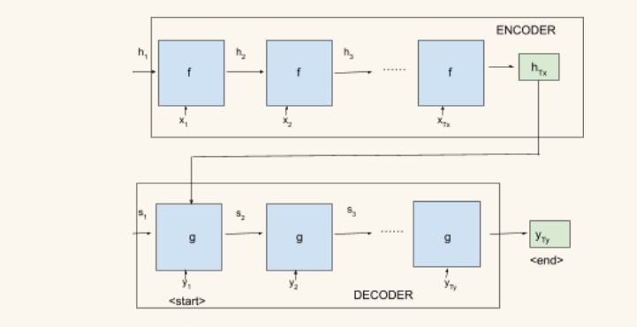
Encoder–Decoder for Neural Machine Translation (NMT)
Workflow for Translation:
Encoder reads the source language sentence
e.g., English sentence
Context vector represents the meaning of the sentence
Decoder generates the translated sentence
e.g., French or German or Hindi
Outcome: End-to-end learning of translation without manual feature engineering

Slide 17
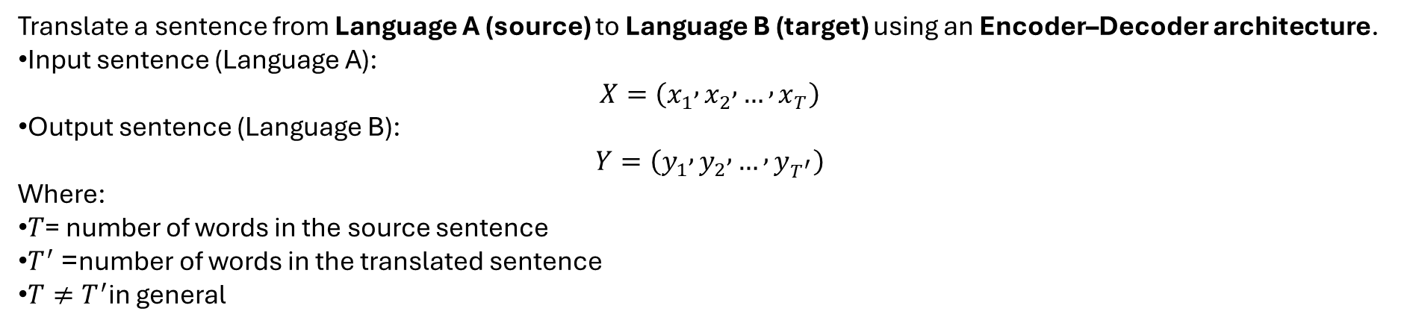
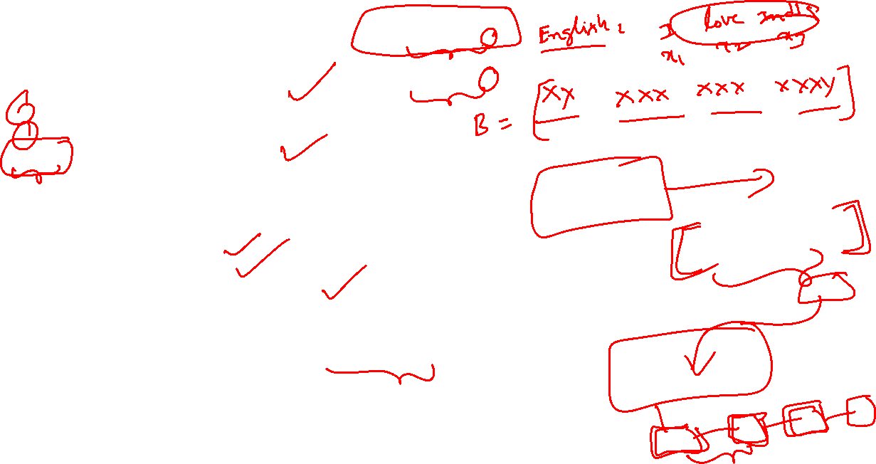
Translate a sentence from Language A (source) to Language B (target) using an Encoder–Decoder architecture.
Input sentence (Language A):
$$X=\left(x_{1} , x_{2} , … , x_{T}\right)$$
Output sentence (Language B):
$$Y=\left(y_{1} , y_{2} , … , y_{T^{′}}\right)$$
Where:
$T$= number of words in the source sentence
$T^{′}$= number of words in the translated sentence
$T≠T^{′}$in general
Why Encoder–Decoder for Translation?
Source and target sentences may have:
  Different lengths
  Different word orders
  Different grammatical structures
Encoder–Decoder architecture:
  Encodes the source sentence into a context representation
  Decodes it into a target sentence one word at a time
Naturally handles variable-length sequences

Slide 18
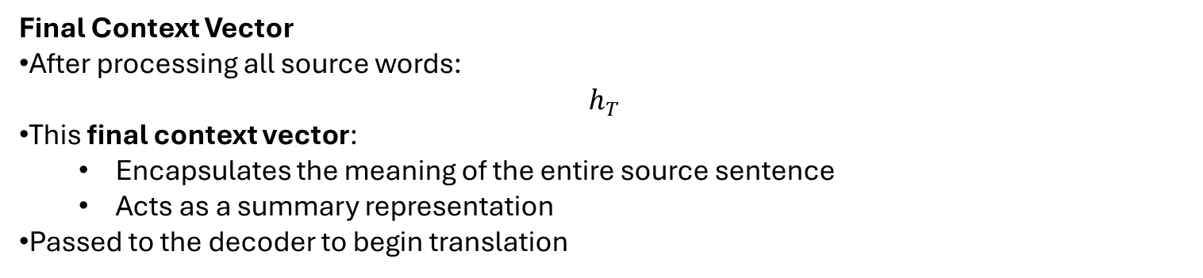
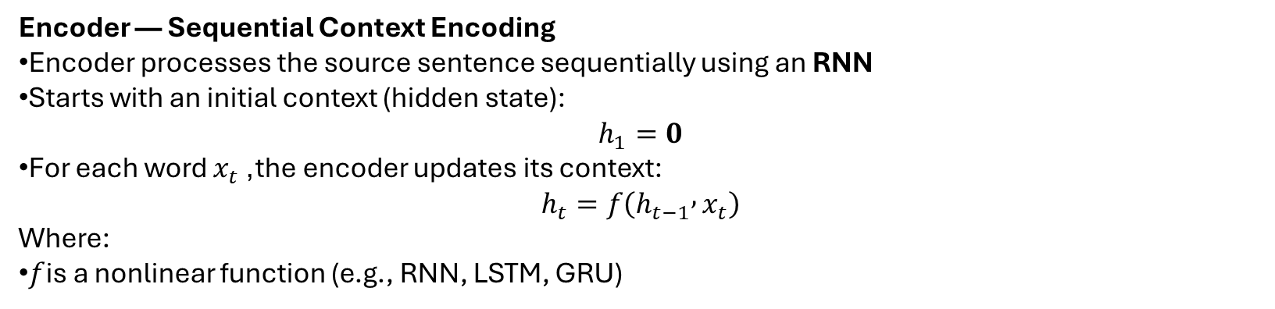
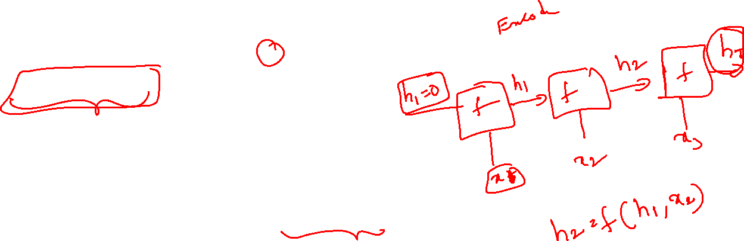
Encoder — Sequential Context Encoding
Encoder processes the source sentence sequentially using an RNN
Starts with an initial context (hidden state):
$$h_{1}=0$$
For each word $x_{t}$, the encoder updates its context:
$$h_{t}=f\left(h_{t−1} , x_{t}\right)$$
Where:
$f$is a nonlinear function (e.g., RNN, LSTM, GRU)
Final Context Vector
After processing all source words:
$$h_{T}$$
This final context vector:
  Encapsulates the meaning of the entire source sentence
  Acts as a summary representation
Passed to the decoder to begin translation

Slide 19
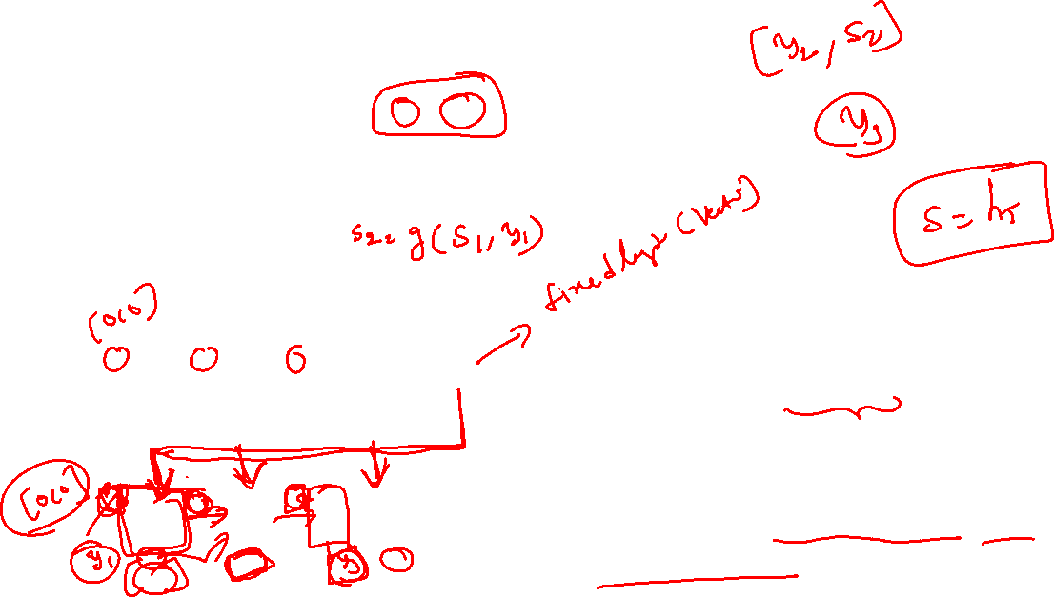
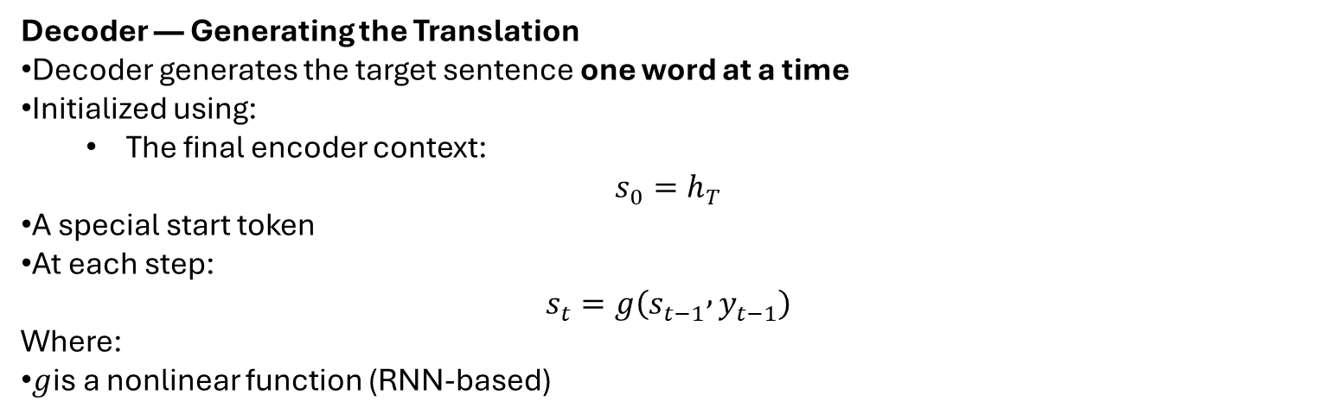
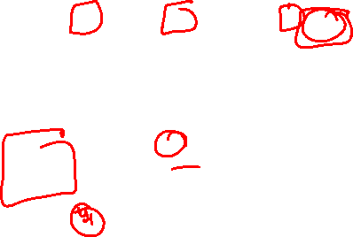
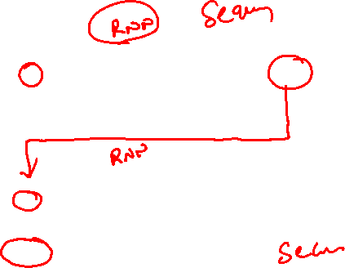

Decoder — Generating the Translation
Decoder generates the target sentence one word at a time
Initialized using:
  The final encoder context:
$$s_{0}=h_{T}$$
A special start token
At each step:
$$s_{t}=g\left(s_{t−1} , y_{t−1}\right)$$
Where:
$g$is a nonlinear function (RNN-based)
The final encoder context vector is used only to initialize the decoder (at the first-time step).
After that, the decoder does not revisit the encoder.
All future decoding steps depend only on the decoder’s own hidden states and previous outputs.

Slide 20
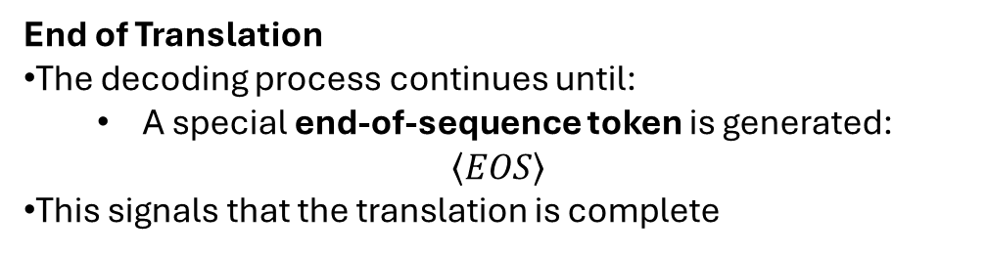
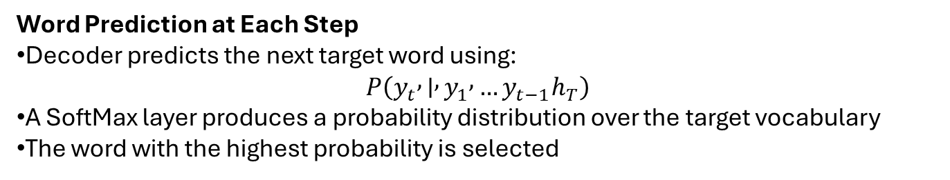
Word Prediction at Each Step
Decoder predicts the next target word using:
$$P\left(y_{t} , ∣ , y_{1} , …y_{t−1}h_{T}\right)$$
A SoftMax layer produces a probability distribution over the target vocabulary
The word with the highest probability is selected
End of Translation
The decoding process continues until:
  A special end-of-sequence token is generated:
$$\left\langle EOS\right\rangle$$
This signals that the translation is complete

Slide 21

Challenges with Standard Encoder–Decoder Models
Standard encoder–decoder models encode the entire source sentence into a single fixed-length vector
This approach works reasonably well for short sentences
However, it becomes problematic when dealing with longer sentences
Key Challenge:
All information—important and unimportant—must be compressed into one vector
Why Long Sentences Are Difficult
Long sentences contain:
  More words
  More dependencies
  More semantic information
The encoder must remember:
  Early words
  Mid-sentence context
  Late information
Result:
Important information may be lost
Earlier words may be overshadowed by later ones

Slide 22

Fixed-Length Context Bottleneck
The final encoder hidden state is a fixed-size vector
Regardless of sentence length:
  Short sentence → same vector size
  Long sentence → same vector size
This creates a bottleneck, especially when:
Translating long or complex sentences
Handling rich grammatical structures
Human Translation Intuition
How humans translate sentences:
We do not remember the entire sentence at once
We focus on relevant words or phrases
Attention shifts depending on:
  Which word we are translating
  The meaning we want to convey
Insight:
Translation is a selective and dynamic process

Slide 23
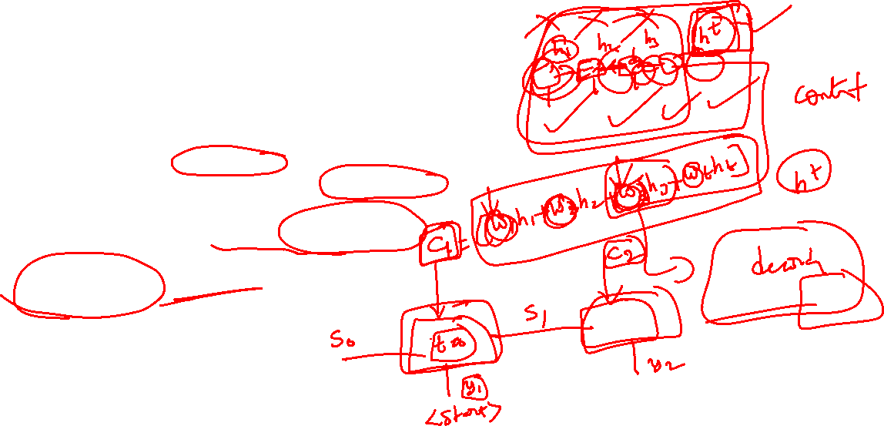
Motivation for Attention Mechanism
Instead of relying on a single context vector:
  Let the decoder look back at the source sentence
At each decoding step:
  Focus only on the most relevant parts of the input
This idea leads to the attention mechanism
Attention-Based Translation Idea
When generating each target word:
  The decoder examines all encoder hidden states
  Assigns importance to different source words
A new context vector is computed at every time step
Key Difference:
Context is dynamic, not fixed

Slide 24
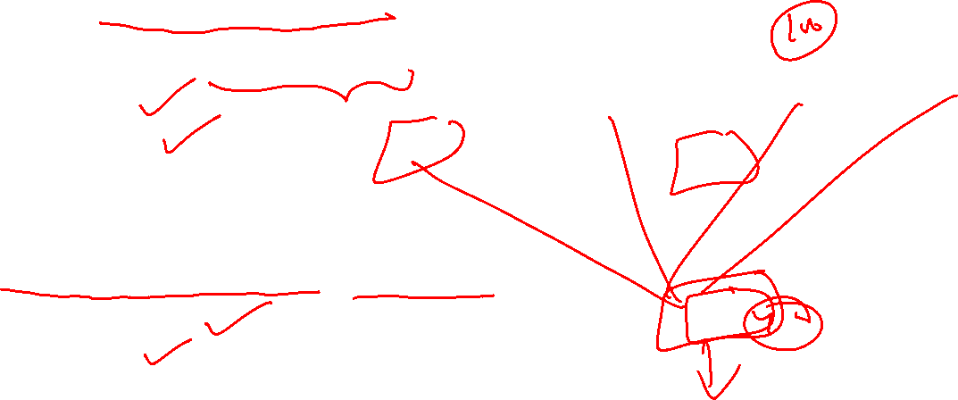
Reducing the Encoder’s Burden
Encoder no longer needs to:
  Compress all information into a single vector
Instead:
  It provides a sequence of contextual representations
Decoder decides:
  What to focus on
  When to focus on it
Learning to Align and Translate
Attention allows the model to:
  Learn soft alignments between source and target words
  Translate more accurately
Particularly effective for:
  Long sentences
  Complex sentence structures

Slide 25
Benefits of Attention for Long Sentences
Better handling of long-range dependencies
Improved translation quality
More interpretable models
Context-sensitive word generation
Key Takeaway
Standard encoder–decoder models struggle with long sentences due to fixed-length context
Attention introduces:
  Dynamic context selection
  Better alignment between source and target
This marks a major improvement in neural machine translation

Slide 26

Attention vs Traditional Encoder – Decoder
Traditional E–D | E–D with Attention
Single context vector | Dynamic context vector
Information bottleneck | No bottleneck
Weak long-sequence handling | Strong long-sequence handling
No explicit alignment | Learns soft alignments

Slide 27
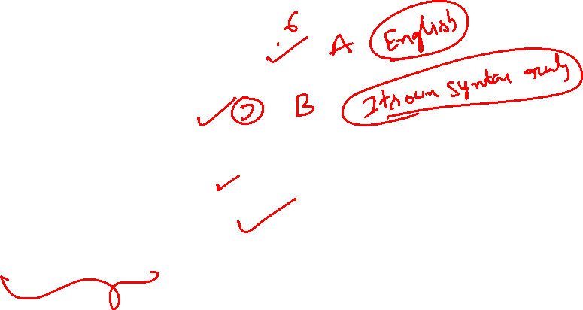
Problem — Natural Language to Code Translation
Task: Translate an English instruction into Python code using a sequence-to-sequence model.
Input (English):
“Python program to print hello world.”
Output (Python):
print("hello world")
This is a sequence-to-sequence problem
Input and output sequences:
Differ in length
Follow different syntactic rules
Encoder–Decoder architecture is used to model this transformation

Slide 28
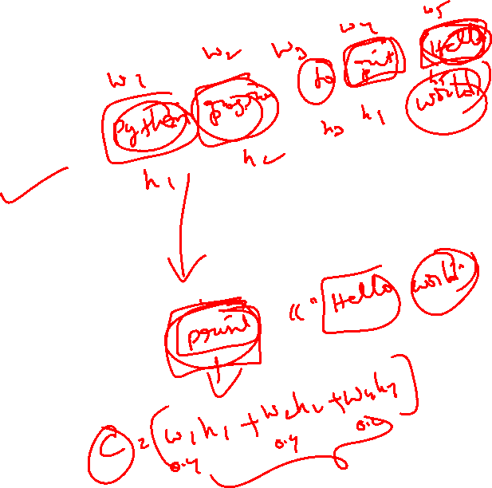
Standard Encoder–Decoder Limitation
The Encoder processes the input sentence word by word:
  “Python” → vector
  “program” → vector
  …
  “world” → vector
Final encoder output:
  A single fixed-length context vector
  Intended to capture the entire meaning of the sentence
Limitation:
For long or complex sentences:
  Too much information is forced into one vector
  Important details may be lost

Slide 29
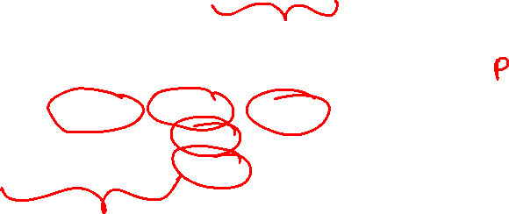
Attention — Dynamic Context Selection
Attention mechanism removes the single-vector bottleneck
At each decoding step, the decoder:
  Looks back at the input sentence
  Focuses on the most relevant words
Example:
Generating print → attends to “Python”, “program”
Generating "hello" → attends to “hello”
Generating "world" → attends to “world”
Key Benefit:
More accurate translations
Better handling of long sentences
Improved alignment between input and output

Slide 30
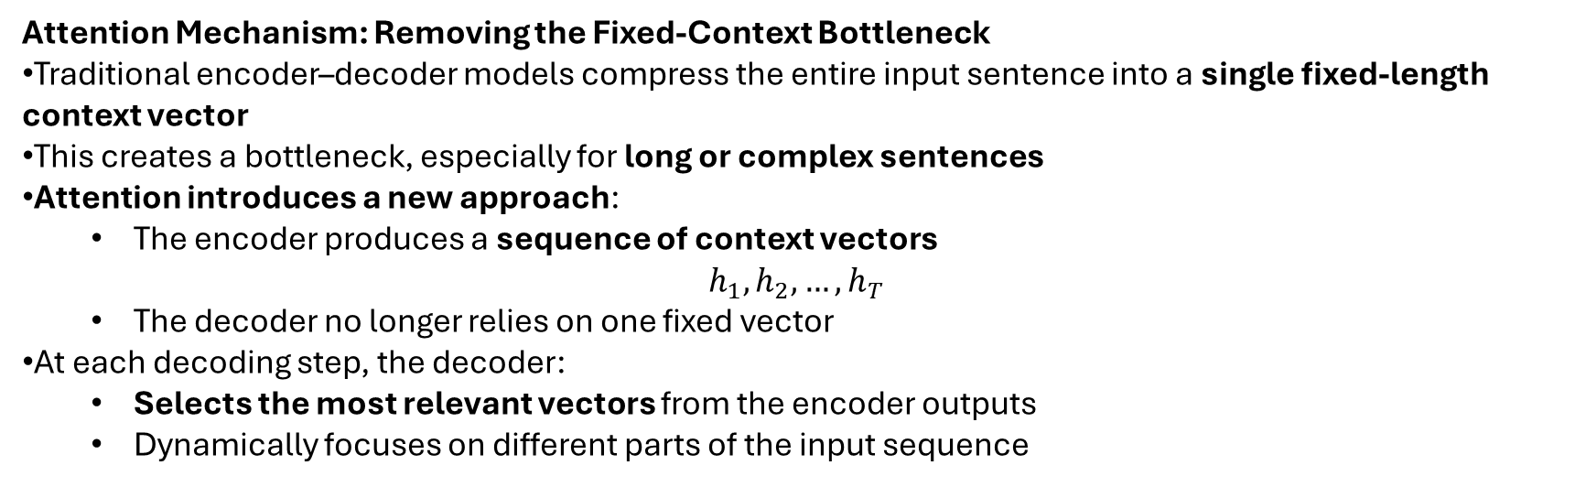

Attention Mechanism: Removing the Fixed-Context Bottleneck
Traditional encoder–decoder models compress the entire input sentence into a single fixed-length context vector
This creates a bottleneck, especially for long or complex sentences
Attention introduces a new approach:
  The encoder produces a sequence of context vectors
$$h_{1},h_{2},…,h_{T}$$
  The decoder no longer relies on one fixed vector
At each decoding step, the decoder:
  Selects the most relevant vectors from the encoder outputs
  Dynamically focuses on different parts of the input sequence
Key Benefit:
The decoder adapts its focus at every stage of translation
The encoder is relieved from compressing all information into one vector
Significantly improves performance on long sentences

Slide 31
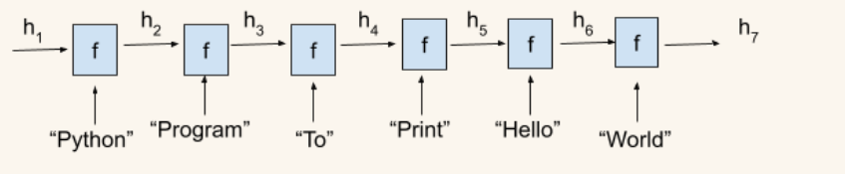
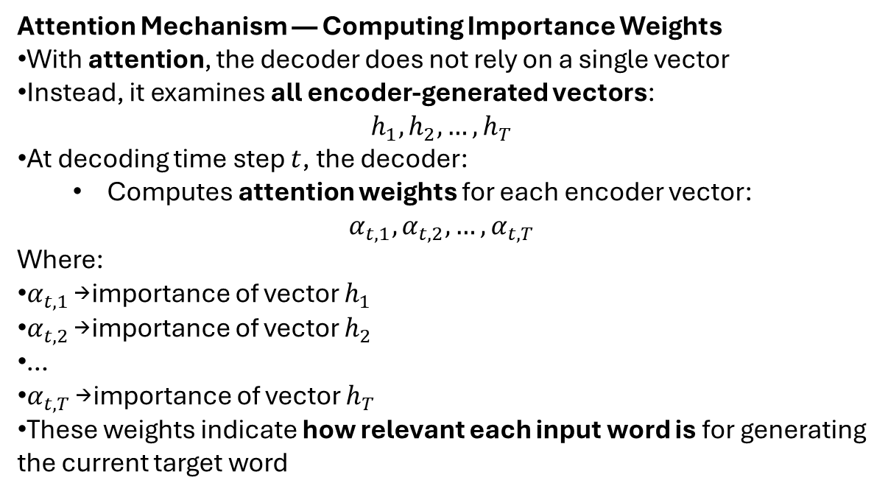
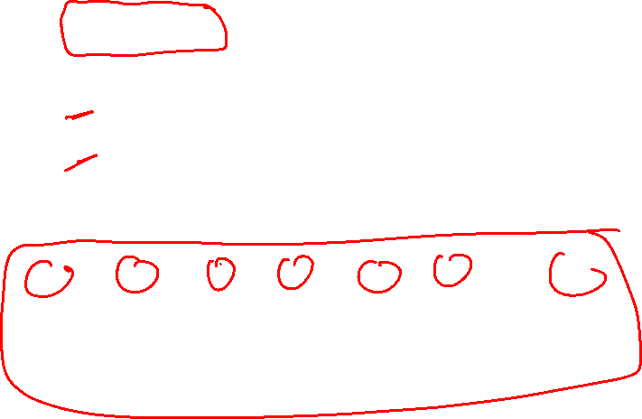
Attention Mechanism — Computing Importance Weights
With attention, the decoder does not rely on a single vector
Instead, it examines all encoder-generated vectors:
$$h_{1},h_{2},…,h_{T}$$
At decoding time step $t$, the decoder:
  Computes attention weights for each encoder vector:
$$α_{t,1},α_{t,2},…,α_{t,T}$$
Where:
$α_{t,1}$→ importance of vector $h_{1}$
$α_{t,2}$→ importance of vector $h_{2}$
…
$α_{t,T}$→ importance of vector $h_{T}$
These weights indicate how relevant each input word is for generating the current target word

Slide 32
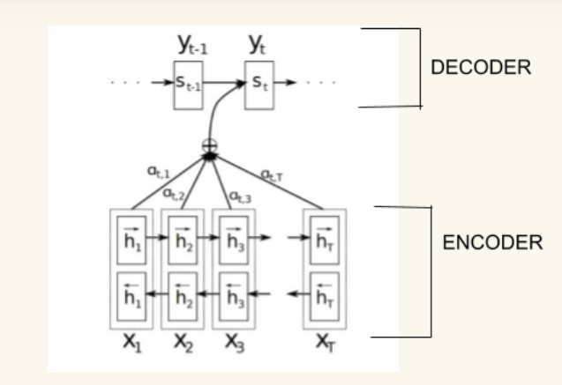
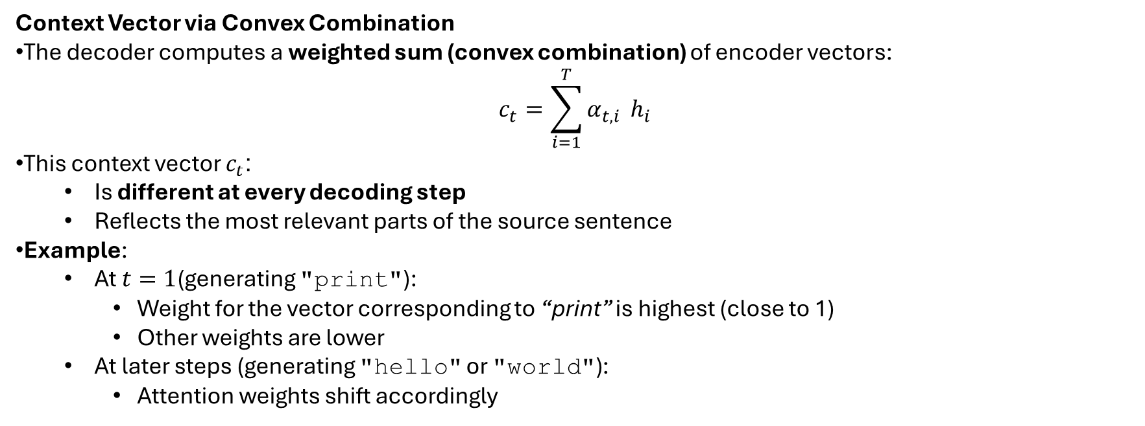
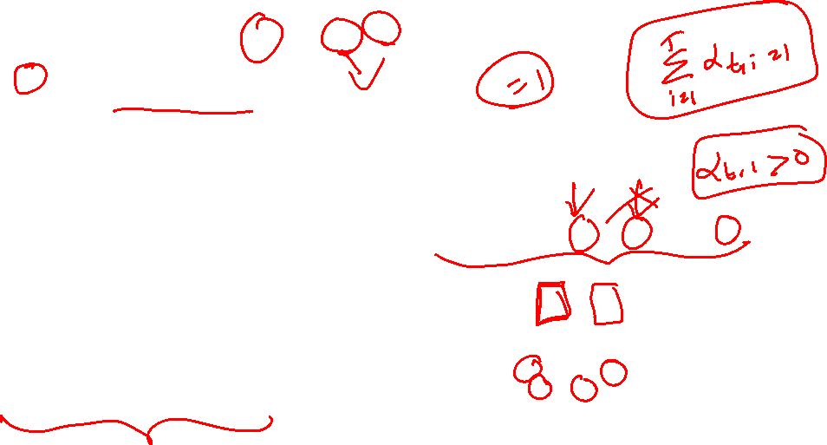
Context Vector via Convex Combination
The decoder computes a weighted sum (convex combination) of encoder vectors:
$$c_{t}=\sum_{i=1}^{T}{α_{t,i}} h_{i}$$
This context vector $c_{t}$:
  Is different at every decoding step
  Reflects the most relevant parts of the source sentence
Example:
  At $t=1$(generating "print"):
    Weight for the vector corresponding to “print” is highest (close to 1)
    Other weights are lower
  At later steps (generating "hello" or "world"):
    Attention weights shift accordingly
Key Advantage:
The model dynamically focuses on relevant input words
Leads to more accurate and context-aware translations

Slide 33
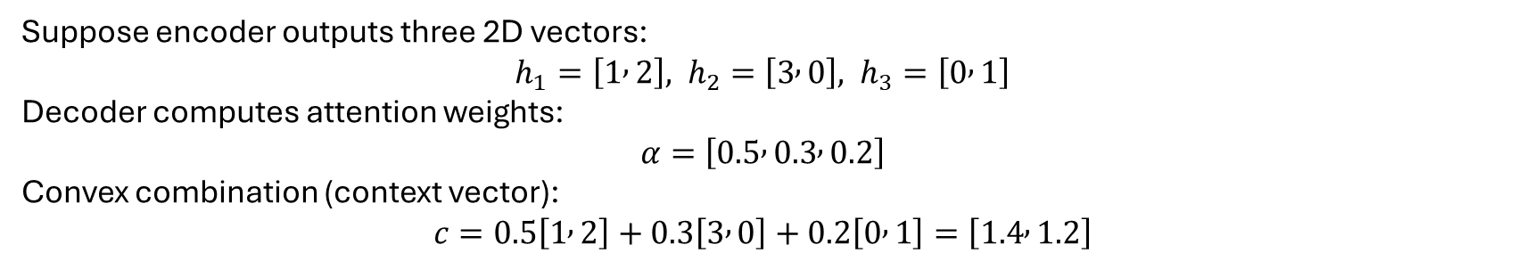
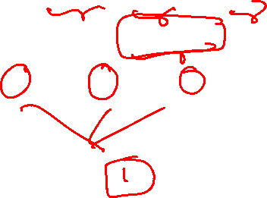
A convex combination is a weighted sum of vectors where weights are non-negative and sum to 1. In attention, the decoder computes the context vector as a convex combination of encoder states, giving more weight to relevant words in the input sequence.
Suppose encoder outputs three 2D vectors:
$$h_{1}=\left[1 , 2\right], h_{2}=\left[3 , 0\right], h_{3}=\left[0 , 1\right]$$
Decoder computes attention weights:
$$α=\left[0.5 , 0.3 , 0.2\right]$$
Convex combination (context vector):
$$c=0.5\left[1 , 2\right]+0.3\left[3 , 0\right]+0.2\left[0 , 1\right]=\left[1.4 , 1.2\right]$$

Slide 34
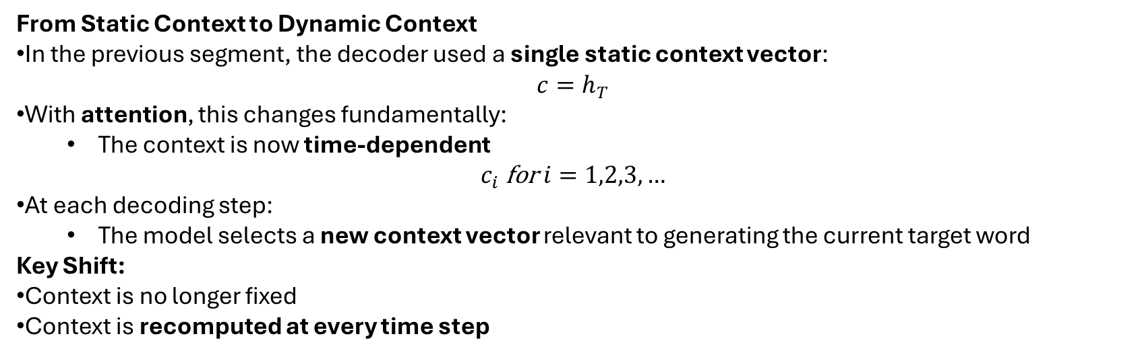
From Static Context to Dynamic Context
In the previous segment, the decoder used a single static context vector:
$$c=h_{T}$$
With attention, this changes fundamentally:
  The context is now time-dependent
$$c_{i} \text{for} i=1,2,3,…$$
At each decoding step:
  The model selects a new context vector relevant to generating the current target word
Key Shift:
Context is no longer fixed
Context is recomputed at every time step

Slide 35
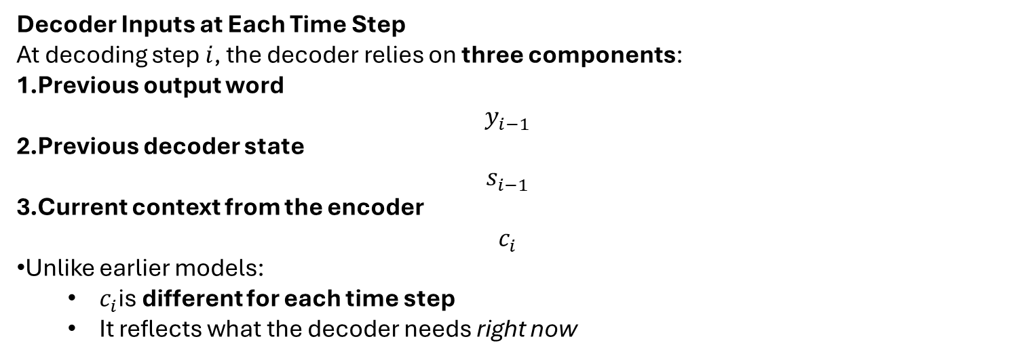
Decoder Inputs at Each Time Step
At decoding step $i$, the decoder relies on three components:
Previous output word
$$y_{i−1}$$
Previous decoder state
$$s_{i−1}$$
Current context from the encoder
$$c_{i}$$
Unlike earlier models:
  $c_{i}$is different for each time step
  It reflects what the decoder needs right now

Slide 36
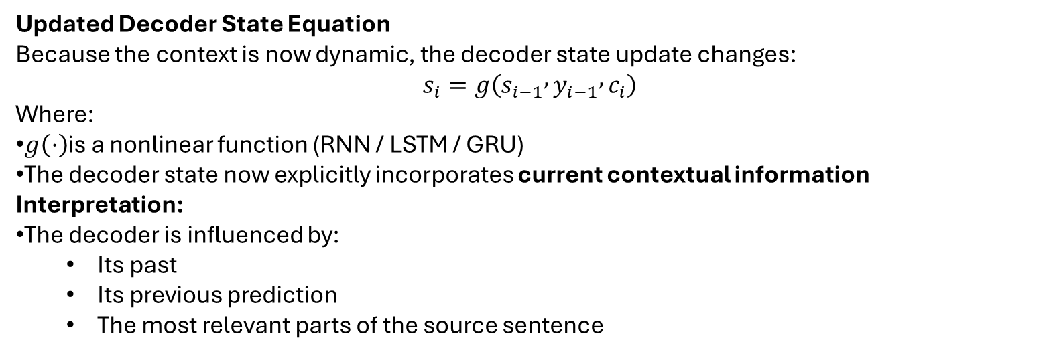
Updated Decoder State Equation
Because the context is now dynamic, the decoder state update changes:
$$s_{i}=g\left(s_{i−1} , y_{i−1} , c_{i}\right)$$
Where:
$g\left(⋅\right)$is a nonlinear function (RNN / LSTM / GRU)
The decoder state now explicitly incorporates current contextual information
Interpretation:
The decoder is influenced by:
  Its past
  Its previous prediction
  The most relevant parts of the source sentence

Slide 37
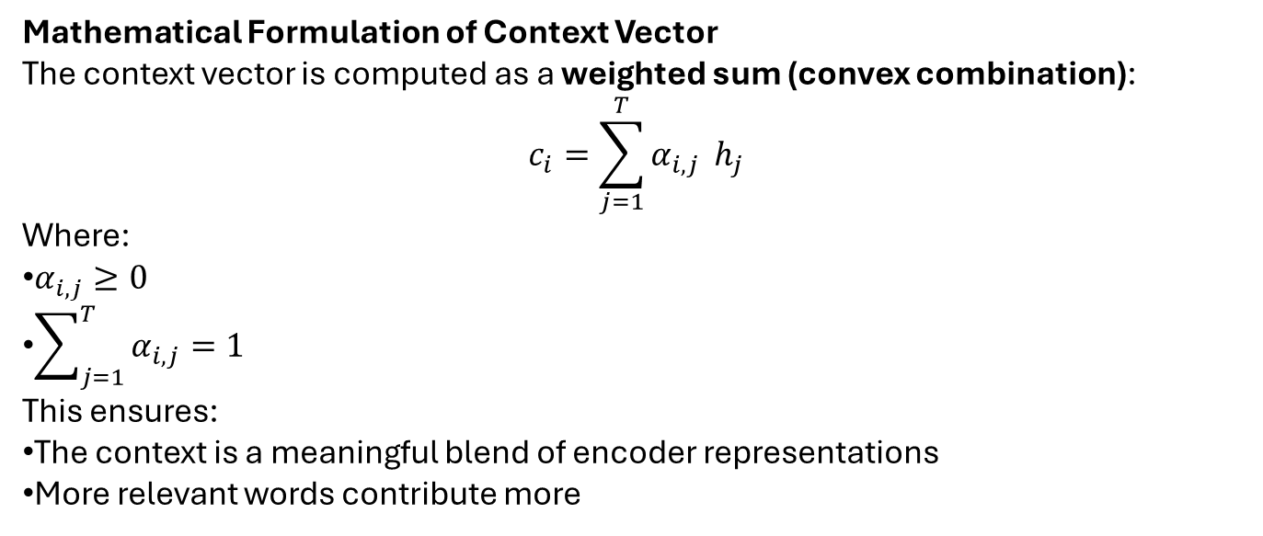
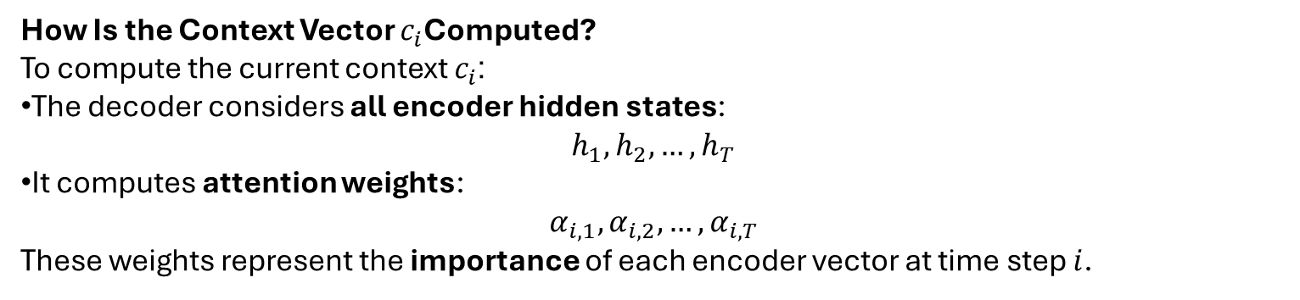

How Is the Context Vector $c_{i}$Computed?
To compute the current context $c_{i}$:
The decoder considers all encoder hidden states:
$$h_{1},h_{2},…,h_{T}$$
It computes attention weights:
$$α_{i,1},α_{i,2},…,α_{i,T}$$
These weights represent the importance of each encoder vector at time step $i$.
Mathematical Formulation of Context Vector
The context vector is computed as a weighted sum (convex combination):
$$c_{i}=\sum_{j=1}^{T}{α_{i,j}} h_{j}$$
Where:
$α_{i,j}≥0$
$\sum_{j=1}^{T}{α_{i,j}}=1$
This ensures:
The context is a meaningful blend of encoder representations
More relevant words contribute more

Slide 38
Intuition Behind the Mathematics
At each decoding step:
  One or a few encoder vectors receive higher weights
Example:
  Generating "print" → higher weight on “print / program”
  Generating "hello" → higher weight on “hello”
Result:
The decoder focuses on the right information at the right time
Leads to more accurate and context-aware generation

Slide 39
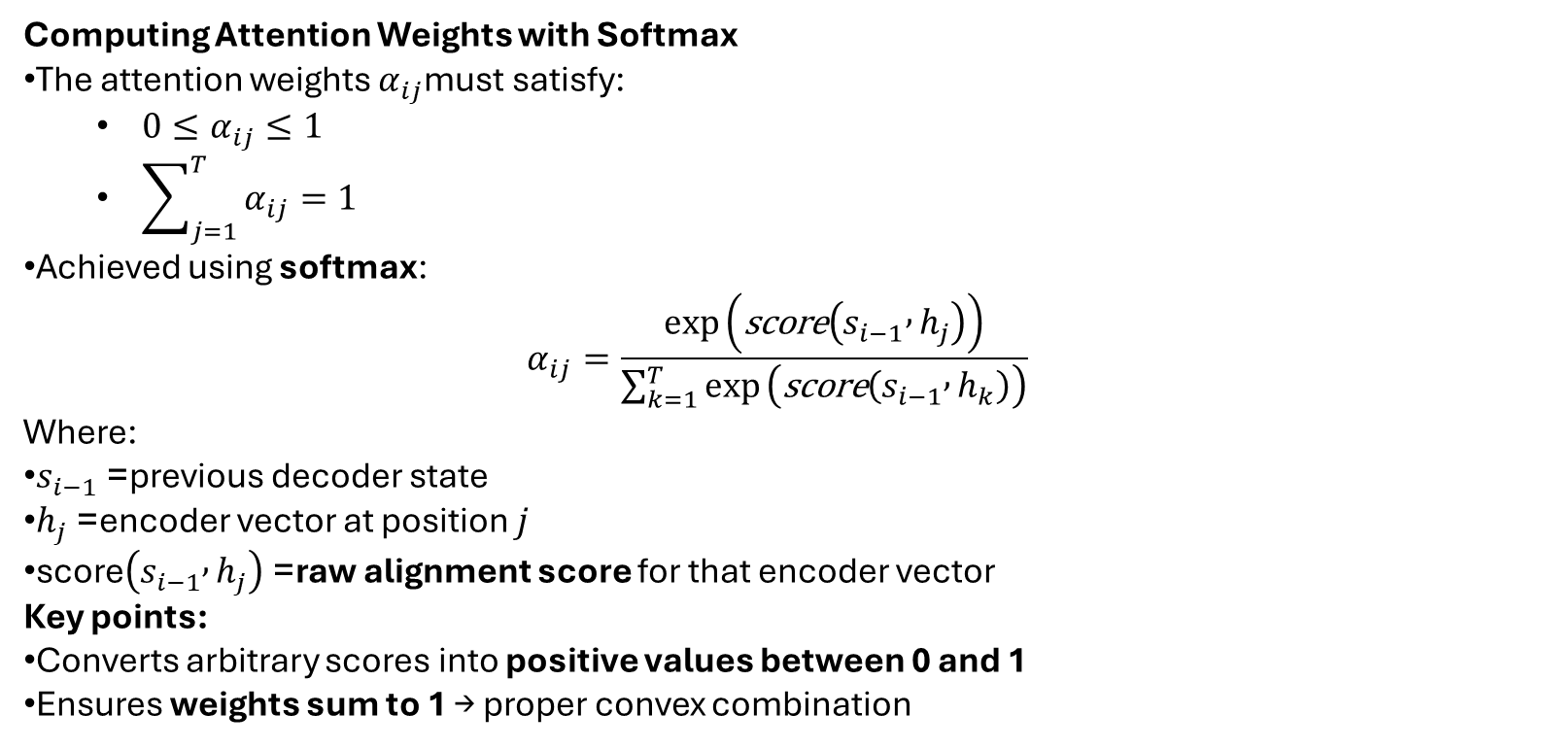
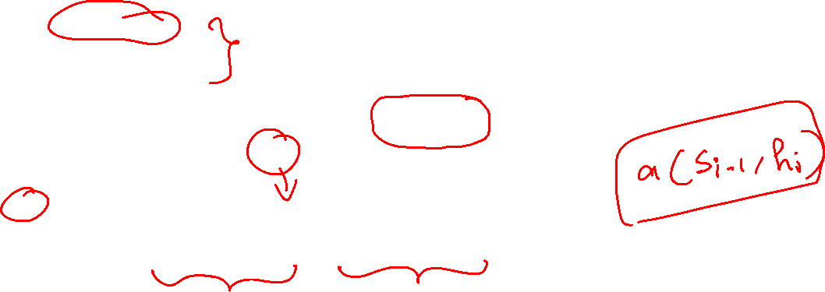
Computing Attention Weights with Softmax
The attention weights $α_{ij}$must satisfy:
  $0≤α_{ij}≤1$
  $\sum_{j=1}^{T}{α_{ij}}=1$
Achieved using softmax:
$$α_{ij}=\frac{exp⁡\left(\text{score}\left(s_{i−1} , h_{j}\right)\right)}{\sum_{k=1}^{T}{exp}⁡\left(\text{score}\left(s_{i−1} , h_{k}\right)\right)}$$
Where:
$s_{i−1}$= previous decoder state
$h_{j}$= encoder vector at position $j$
$\text{score}\left(s_{i−1} , h_{j}\right)$= raw alignment score for that encoder vector
Key points:
Converts arbitrary scores into positive values between 0 and 1
Ensures weights sum to 1 → proper convex combination

Slide 40
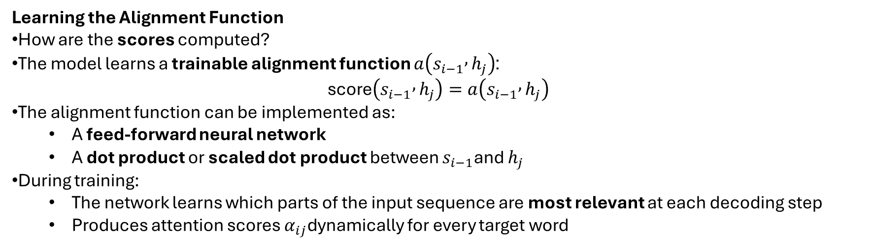
Learning the Alignment Function
How are the scores computed?
The model learns a trainable alignment function $a\left(s_{i−1} , h_{j}\right)$:
$$\text{score}\left(s_{i−1} , h_{j}\right)=a\left(s_{i−1} , h_{j}\right)$$
The alignment function can be implemented as:
  A feed-forward neural network
  A dot product or scaled dot product between $s_{i−1}$and $h_{j}$
During training:
  The network learns which parts of the input sequence are most relevant at each decoding step
  Produces attention scores $α_{ij}$dynamically for every target word
The scores are not predetermined - they are learned by the model during training. The model learns an alignment function, a, that determines the attention scores at each time step.
Takeaway:
The context vector $c_{i}$is now dynamic, weighted, and learned, enabling the decoder to focus on the right parts of the input at each step.

Slide 41

Limitations of RNN-Based Attention
Still sequential in nature
Limited parallelization
Slow for very long sequences
What Next ?
Processing sequences in parallel
Eliminating recurrence
Foundations of Transformer architectures

Slide 42

Key Takeaways
Attention allows the model to focus dynamically
Solves the encoder bottleneck problem
Integral part of modern sequence models
Sets the stage for fully parallel architectures

Slide 43

Questions?

